Slide 1
NEO
START Hack 2018
Charlie Revett
Friday 23rd February 2018

Slide 2
What is NEO?

Slide 3



Public blockchain (top 10)
Team based in Shanghai
Created in 2014
Smart Economy
Digital assets
Digital identity
Smart contracts

Slide 4
The Challenge

Slide 5
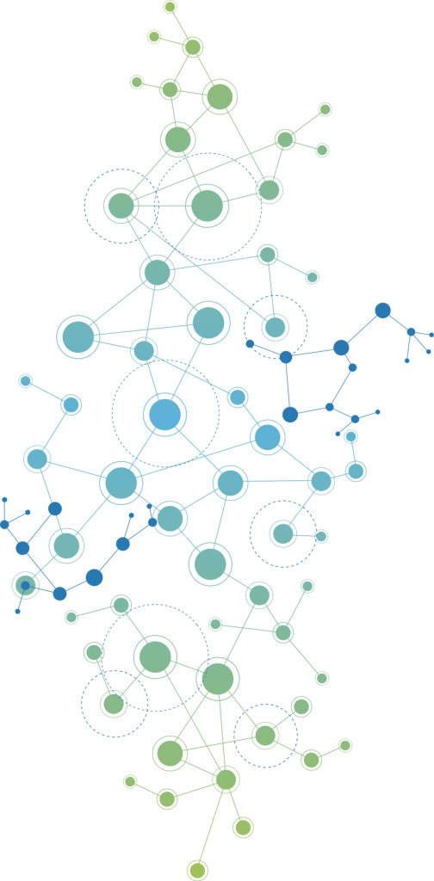
Build a decentralised application (dApp) on the NEO blockchain

Slide 6
The Prize

Slide 7
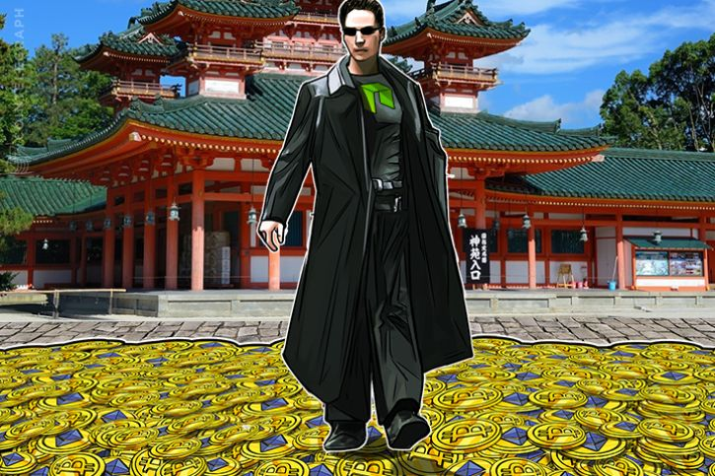
500 GAS
(around $20000)

Slide 8
Come to the smart contract workshop!
@charlierevett
Join the NEO chat - discord.cityofzion.io

